Slide 1
mouse control using hand movements

Slide 2
ABSTRACT:
By using hand gestures we use hand as a medium using camera and moving the mouse based on the the hand gestures ,habd gestures and then use a regression model to move the mouse , this will help in less use age of mouse,
and using this process the mouse will not work

Slide 3
Introduction
mouse movements came from hand gestures is a challenging task in computer vision and biometrics. Accurate estimation of hand image should be the in the allocated box
hand image Extraction: This is to extract the hand features from the preprocessed hand images in the box. hand recognition is a critical step in movements in the mouse, the quality and relevance of the input data to the prediction model.

Slide 4
steps
use css to create a box in a space and use the grid formula and connect the box space to the space around the desktop
use the camera and identify the hand present int box and gather the coordinates of the box and use gaph use calculation place cursor at the appropiate position in the desktop
every time the hand changes position caluculate new position and move the mouse

Slide 5
Features
Toggle switch to turn AI on or off
Range slider to control frame rate
Mouse example to show a possible usage case
Configurable border in mouse example

Slide 6
languages USED
jss
css
javascript
python

Slide 7
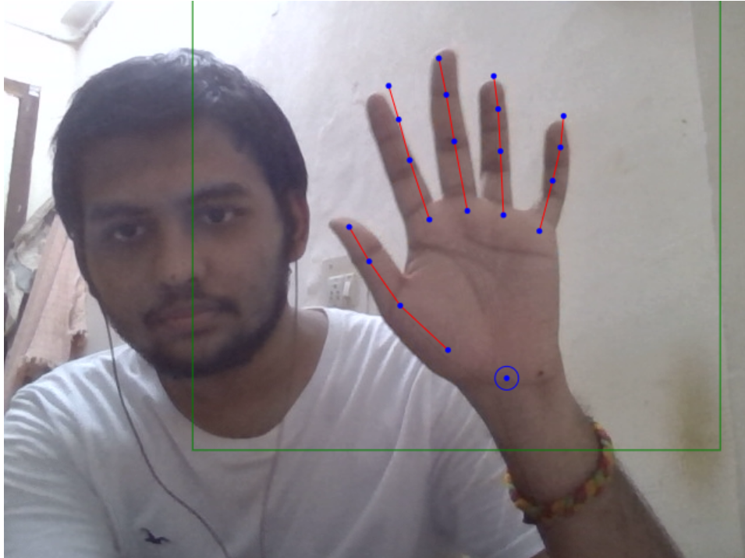

Slide 8
